Slide 1
Chapter 18
How to work with Ajax

Slide 2
Objectives (part 1)
Applied
Use your browser to review the response that’s returned from a request to a web service.
Use the Fetch API to make Ajax requests that update a web page without reloading it.
Knowledge
In general terms, describe how Ajax works.
Distinguish between XML and JSON.
Describe how to use an API for a web service to get data from a website.
Describe how to use a browser to request data from a web service and review its response.
Distinguish between the XMLHttpRequest object and the Fetch API.

Slide 3
Objectives (part 2)
Describe how a callback function works and why callback functions are essential to asynchronous programming.
Describe these Fetch API methods: fetch(), then(), catch(), and json().
Name and describe the three states of a Promise object.
Describe the “callback hell” problem and how the Fetch API solves that problem.
Describe how named functions can make a chain of promises easier to read, understand, and maintain.
Describe how you can use the async and await keywords to work with asynchronous functions.
Describe how you can use a server-side proxy to get data from a web service that doesn’t allow cross-origin requests.

Slide 4
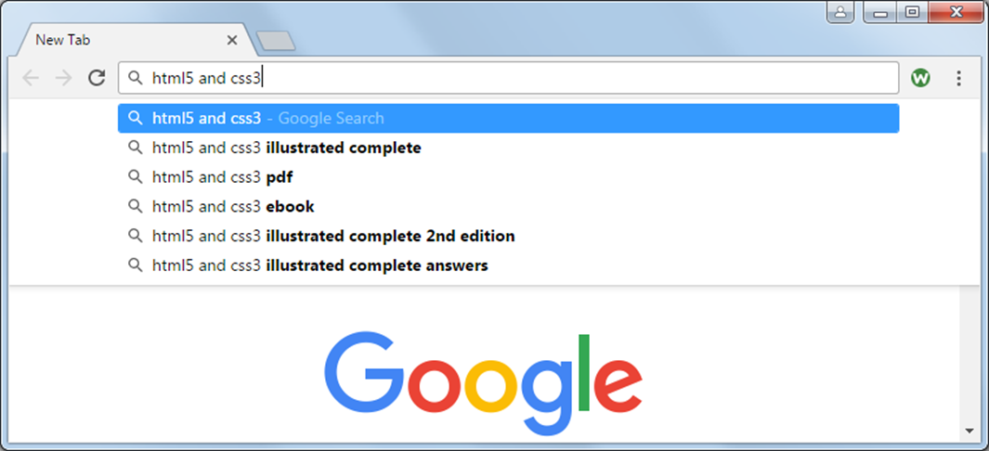
Google’s Auto Suggest is an Ajax application

Slide 5
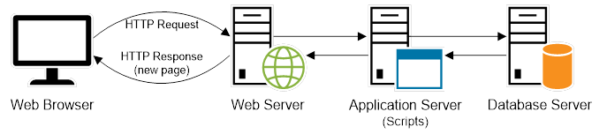
How a normal HTTP request is processed

Slide 6
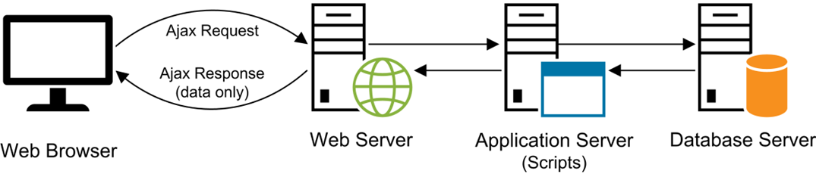
How an Ajax request is processed

Slide 7
Terms related to Ajax
Ajax (Asynchronous JavaScript and XML)
XMLHttpRequest (XHR) object
Fetch API
web service
API (Application Programming Interface)

Slide 8
Two common data formats for Ajax
Format Description File extension
XML Extensible Markup Language xml
JSON JavaScript Object Notation json

Slide 9
XML data
<?xml version="1.0" encoding="utf-8"?>
<management>
<teammember>
<name>Agnes</name>
<title>Vice President of Accounting</title>
<bio>With over 14 years of public accounting ... </bio>
</teammember>
<teammember>
<name>Wilbur</name>
<title>Founder and CEO</title>
<bio>While Wilbur is the founder and CEO ... </bio>
</teammember>
</management>

Slide 10
JSON data
{"teammembers":[
{
"name":"Agnes",
"title":"Vice President of Accounting",
"bio":"With over 14 years of public accounting... "
},
{
"name":"Wilbur",
"title":"Founder and CEO",
"bio":"While Wilbur is the founder and CEO ... "
}
]}

Slide 11
Terms related to data formats for Ajax
XML (Extensible Markup Language)
JSON (JavaScript Object Notation)

Slide 12
The JSON Placeholder web service
https://jsonplaceholder.typicode.com
The fake data that’s available from this web service
Resource Description
/users 10 users with data such as name, username, and email address.
/posts 100 blog posts each related to a specific user.
/comments 500 comments each related to a specific blog post.
/albums 100 photo albums each related to a specific user.
/photos 5000 simple photos of various colors each related to a specific album. Includes one 600x600 pixel photo and a 150x150 pixel thumbnail.
/todos 200 tasks each related to a specific user.

Slide 13
A URL that returns data
https://jsonplaceholder.typicode.com/users
Some of the JSON that’s returned
[
{
"id": 1,
"name": "Leanne Graham",
"username": "Bret",
"email": "Sincere@april.biz",
...
}
},
...
{
"id": 10,
"name": "Clementina DuBuque",
"username": "Moriah.Stanton",
"email": "Rey.Padberg@karina.biz",
...
}
}
]

Slide 14
Common members of the XMLHttpRequest object
Methods
open(method,url)
send([data])
Property
responseType
response
readyState
status
Event
onreadystatechange
onerror

Slide 15
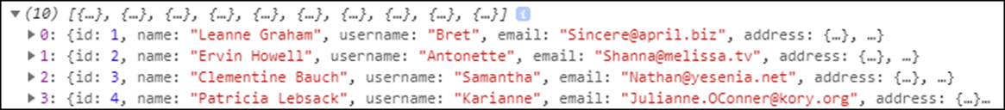
Code that uses the XMLHttpRequest object to get and display user data
const xhr = new XMLHttpRequest();
xhr.responseType = "json";
xhr.onreadystatechange = () => {
if (xhr.readyState == 4 && xhr.status == 200) {
console.log(xhr.response);
}
};
xhr.onerror = e => console.log(e.message);
xhr.open("GET",
"https://jsonplaceholder.typicode.com/users");
xhr.send();
The data displayed in the console

Slide 16
Terms related to the XMLHttpRequest object
member of an object
callback function

Slide 17
One method of the Fetch API
Method Description
fetch(url) Makes an asynchronous GET request to the specified URL. Returns a Promise object that eventually returns a Response object.

Slide 18
Two methods of the Promise object
Method Description
then(callback) Registers the callback function to execute when the promise is resolved. The callback function receives a single parameter, which is the eventual return value of the asynchronous request. Returns a Promise object.
catch(callback) Registers the callback function to execute when the promise is rejected. The callback function receives a single parameter, which is usually an Error object. Returns a Promise object.

Slide 19
One method of the Response object
Method Description
json() Returns a Promise object that eventually resolves to a JavaScript object that’s created from the JSON that’s returned by the asynchronous request.

Slide 20
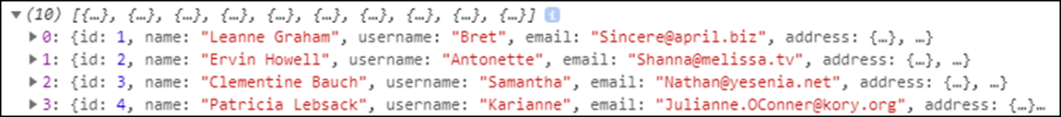
Code that uses the Fetch API to get and display user data
fetch("https://jsonplaceholder.typicode.com/users")
.then( response => response.json() )
.then( json => console.log(json) )
.catch( e => console.log(e.message) );
The data displayed in the console

Slide 21

The Astronomy Picture Of the Day application

Slide 22
The HTML for the APOD application
<body>
<main>
<h1>Astronomy Picture Of the Day</h1>
<div>
<label for="date">Enter date:</label>
<input type="text" name="date" id="date">
<input type="button" id="view_button"
value="View">
</div>
<div id="display"></div>
</main>
<script
src="https://code.jquery.com/jquery-3.4.1.min.js">
</script>
<script src="apod.js"></script>
</body>

Slide 23
Some of the CSS for the APOD application
div {
margin-bottom: 1em;
}
label {
display: inline-block;
width: 5em;
}
input {
margin-right: 0.5em;
}
.error {
color: red;
}
.right {
float: right;
}

Slide 24
The URL for NASA’s Astronomy Picture of the Day (APOD) API
https://api.nasa.gov/planetary/apod
Parameters
Parameter Description
api_key The API key for the web service.
date The date of the APOD image to retrieve.
Example URL
https://api.nasa.gov/planetary/ apod?api_key=DEMO_KEY&date=2020-07-22

Slide 25
The JavaScript for the APOD application (part 1)
"use strict";
// returns date string in YYYY-MM-DD format
const getDateString = date =>
`${date.getFullYear()}-${date.getMonth() + 1}-${date.getDate()}`;
const displayPicture = data => {
let html = "";
if(data.error) { // error – display message
html += `<span class="error">${data.error.message}</span>`;
}
else if (data.code) { // problem – display message
html += `<span class="error">${data.msg}</span>`;
}
else { // success – display image/video data
html += `<h3>${data.title}</h3>`;
const width = 700;
switch (data.media_type) {
case "image":
html += `<img src="${data.url}" width="${width}"
alt="NASA photo">`;
break;
case "video":
html += `<iframe src="${data.url}"
frameborder="0"
allowfullscreen></iframe>`;
break;

Slide 26
The JavaScript for the APOD application (part 2)
default:
html += `<img src="images/notavailable.png"
width="${width}" alt="NASA photo">`;
}
// date and copyright
html += `<div>${data.date}`;
if (data.copyright) {
html +=
`<span class="right">&copy; ${data.copyright}</span>`;
}
html += "</div>";
// explanation
html += `<p>${data.explanation}</p>`;
}
// display HTML
$("#display").html(html);
};
const displayError = error => {
let html = `<span class="error">${error.message}</span>`;
$("#display").html(html);
};

Slide 27
The JavaScript for the APOD application (part 3)
$(document).ready( () => {
// on load, get today's date in YYYY-MM-DD format
const today = new Date();
let dateStr = getDateString(today);
// set today's date in textbox
const dateTextbox = $("#date");
dateTextbox.val(dateStr);
dateTextbox.focus();
$("#view_button").click( () => {
// get date from textbox
dateStr = $("#date").val();
const dateObj = new Date(dateStr);
if (dateObj == "Invalid Date") {
const msg = "Please enter valid date in YYYY-MM-DD format.";
$("#display").html(`<span class="error">${msg}</span>`);
}
else {
// make sure date string is in proper format
dateStr = getDateString(dateObj);

Slide 28
The JavaScript for the APOD application (part 4)
// build URL for API request
const domain = `https://api.nasa.gov/planetary/apod`;
const request = `?api_key=DEMO_KEY&date=${dateStr}`;
const url = domain + request;
fetch(url)
.then( response => response.json() )
.then( json => displayPicture(json) )
.catch( e => displayError(e) );
}
$("#date").focus();
});
});

Slide 29
Code that uses the XMLHttpRequest object to get related data (part 1)
const xhr1 = new XMLHttpRequest();
xhr1.responseType = "json";
const domain = "https://jsonplaceholder.typicode.com";
let url = `${domain}/photos/1`;
xhr1.onreadystatechange = () => {
if (xhr1.readyState == 4 && xhr1.status == 200) {
const photo = xhr1.response;
const xhr2 = new XMLHttpRequest();
xhr2.responseType = "json";
url = `${domain}/albums/${photo.albumId}`;
xhr2.onreadystatechange = () => {
if (xhr2.readyState == 4 && xhr2.status == 200) {
const album = xhr2.response;
const xhr3 = new XMLHttpRequest();
xhr3.responseType = "json";
url = `${domain}/users/${album.userId}`;

Slide 30
Code that uses the XMLHttpRequest object to get related data (part 2)
xhr3.onreadystatechange = () => {
if (xhr3.readyState == 4 &&
xhr3.status == 200) {
const user = xhr3.response;
let html = `<img src="${photo.url}"
alt="${photo.title}">`;
html +=
`<h4>In album ${album.title}</h4>`;
html += `Posted by ${user.username}`;
$("#photo").html(html);
}
};
xhr3.open("GET", url);
xhr3.send();
}
};
xhr2.open("GET", url);
xhr2.send();
}
};
xhr1.open("GET", url);
xhr1.send();

Slide 31
Code that uses the Fetch API to get related data
const domain = "https://jsonplaceholder.typicode.com";
fetch(`${domain}/photos/1`)
.then( response => response.json() )
.then( photo => {
$("#photo").html(
`<img src="${photo.url}" alt="${photo.title}">`);
return fetch(`${domain}/albums/${photo.albumId}`)
})
.then( response => response.json() )
.then( album => {
let html = $("#photo").html();
html += `<h4>In album ${album.title}</h4>`;
$("#photo").html(html);
return fetch(`${domain}/users/${album.userId}`)
})
.then( response => response.json() )
.then( user => {
let html = $("#photo").html();
html += `Posted by ${user.username}`;
$("#photo").html(html);
});

Slide 32
Named callback functions that get related data (part 1)
const getPhoto = () =>
fetch(`${domain}/photos/1`)
.then( response => response.json() );
// resolves to photo object
const getPhotoAlbum = photo => {
return fetch(`${domain}/albums/${photo.albumId}`)
.then( response => response.json() )
// resolves to album object
.then( album => {
photo.album = album; // add album property
return photo; // resolves to photo object
});
};

Slide 33
Named callback functions that get related data (part 2)
const getPhotoAlbumUser = photo => {
return fetch(`${domain}/users/${photo.album.userId}`)
.then( response => response.json() )
// resolves to user object
.then( user => {
photo.album.user = user;
// add album.user property
return photo; // resolves to photo object
});
};
const displayPhotoData = photo => {
let html = `<img src="${photo.url}" alt="${photo.title}">`;
html += `<h4>In album ${photo.album.title}</h4>`;
html += `Posted by ${photo.album.user.username}`;
$("#photo").html(html);
};

Slide 34
A promise chain that uses the named callback functions
getPhoto()
.then( photo => getPhotoAlbum(photo) )
.then( photo => getPhotoAlbumUser(photo) )
.then( photo => displayPhotoData(photo) );
A more concise way to code the same promise chain
getPhoto()
.then(getPhotoAlbum)
.then(getPhotoAlbumUser)
.then(displayPhotoData);

Slide 35
One more method of the Promise type
Method Description
finally(callback) Registers the callback function to execute when a promise is settled. The callback function doesn’t receive a parameter. Returns a Promise object.

Slide 36
A catch() method for general errors
getPhoto()
.then(getPhotoAlbum)
.then(getPhotoAlbumUser)
.then(displayPhotoData)
.catch( e => console.log(e.message) );

Slide 37
A catch() method that recovers from an error
const getMyPhoto = id => {
if(id > 0) {
return fetch(`${domain}/photos/${id}`)
.then( response => response.json() );
} else {
return Promise.reject(
new Error("id must be greater than zero."));
}
};
const getGenericPhoto = () => ( {url: "images/genericPhoto.jpg"} );
const displayPhoto = photo => console.log(photo.url);
const logError = e => console.log(e);
getMyPhoto(0)
.catch(getGenericPhoto)
.then(displayPhoto)
.catch(logError);

Slide 38
A finally() method that makes sure a file is closed
readFile()
.then(displayContents)
.catch(logError)
.finally(closeFile);

Slide 39
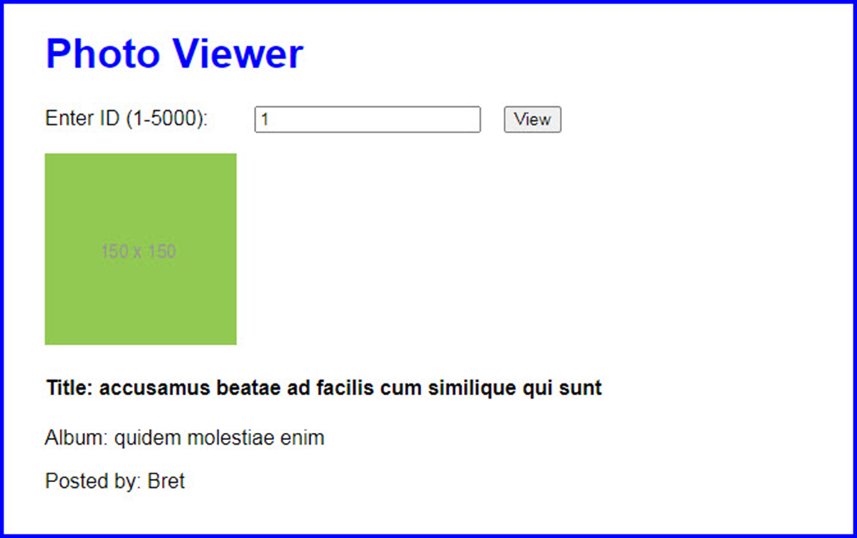
The Photo Viewer application

Slide 40
The HTML for the Photo Viewer application
<body>
<main>
<h1>Photo Viewer</h1>
<div>
<label for="photo_id">Enter ID (1-5000):
</label>
<input type="text" name="photo_id"
id="photo_id" value="1">
<input type="button" id="view_button"
value="View">
</div>
<div id="photo"></div>
</main>
<script
src="https://code.jquery.com/jquery-3.4.1.slim.min.js">
</script>
<script src="photo_viewer.js"></script>
</body>

Slide 41
Some of the CSS for the Photo Viewer application
label {
display: inline-block;
width: 10em;
}
input {
margin-right: 1em;
}

Slide 42
The JavaScript for the Photo Viewer app (part 1)
"use strict";
const domain = "https://jsonplaceholder.typicode.com";
const getPhoto = id => {
if (id < 1 || id > 5000) {
return Promise.reject(
new Error ("Photo ID must be between 1 and 5000."));
} else {
return fetch(`${domain}/photos/${id}`)
.then( response => response.json() );
}
};
const getPhotoAlbum = photo => {
return fetch(`${domain}/albums/${photo.albumId}`)
.then( response => response.json() )
.then( album => {
photo.album = album;
return photo;
});
};

Slide 43
The JavaScript for the Photo Viewer app (part 2)
const getPhotoAlbumUser = photo => {
return fetch(`${domain}/users/${photo.album.userId}`)
.then( response => response.json() )
.then( user => {
photo.album.user = user;
return photo;
});
};
const displayPhotoData = photo => {
let html =
`<img src="${photo.thumbnailUrl}" alt="${photo.title}">`;
html += `<h4>Title: ${photo.title}</h4>`;
html += `<p>Album: ${photo.album.title}</p>`;
html += `Posted by: ${photo.album.user.username}`;
$("#photo").html(html);
};
const displayError = e => {
let html = `<span>${e}</span>`;
$("#photo").html(html);
};

Slide 44
The JavaScript for the Photo Viewer app (part 3)
$(document).ready( () => {
$("#view_button").click( () => {
const photo_id = $("#photo_id").val();
getPhoto(photo_id)
.then(getPhotoAlbum)
.then(getPhotoAlbumUser)
.then(displayPhotoData)
.catch(displayError);
});
});

Slide 45
The syntax of the Promise constructor
const myPromise = new Promise(callback);
The two parameters of the callback passed to the Promise constructor
Parameter Description
resolve The callback function that is passed to the then() method to execute when the promise is resolved.
reject The callback function that is passed to the catch() method to execute when the promise is rejected.

Slide 46
A function that wraps the XMLHttpRequest object in a promise
const myFetch = url => {
return new Promise( (resolve, reject) => {
const xhr = new XMLHttpRequest();
xhr.responseType = "json";
xhr.onreadystatechange = () => {
if (xhr.readyState == 4) {
if (xhr.status == 200) {
resolve(xhr.response)
} else {
reject(new Error(
`Error code: ${xhr.status}`));
}
}
};
xhr.open("GET", url);
xhr.send();
});
};

Slide 47
Code that uses the function
myFetch(`${domain}/todos/`)
.then( todos => console.log(todos) )
.catch( e => console.log(e) );

Slide 48
A function that wraps the setTimeout() function in a Promise
const wait = milliseconds => {
return new Promise( (resolve, reject) => {
if (milliseconds > 0) {
setTimeout(resolve, milliseconds);
} else {
reject( new RangeError(
"Milliseconds must be positive.") );
}
});
}
Code that uses the function
actionThatFailsIntermittently()
.catch( e => wait(200).then( actionThatFailsIntermittently) ) // retry
.then(doSomethingWithDataReturnedByAction)
.catch(logError);

Slide 49
Five static methods of the Promise type
all(promises)
allSettled(promises)
race(promises)
resolve(value)
reject(value)

Slide 50
An array of Promise objects
const fetchUsers = [
fetch(`${domain}/users/1`).then(r => r.json()),
fetch(`${domain}/users/2`).then(r => r.json()),
fetch(`${domain}/users/3`).then(r => r.json())
];
Add a rejected promise to the array
fetchUsers.push( Promise.reject(new Error("Dang!")) );
Execute the array of promises
Promise.all(fetchUsers)
.then( users => console.log(users) )
.catch( e => console.log(e) );
Only the return value of the rejected promise is displayed

Slide 51
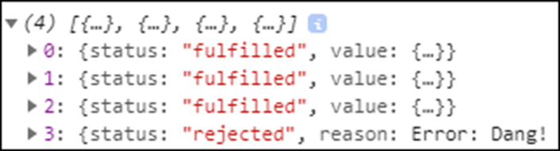
Another way to execute the array of promises
Promise.allSettled(fetchUsers)
.then( users => console.log(users) )
.catch( e => console.log(e) );
The return values of all the promises are displayed

Slide 52
A simple asynchronous function
const getPI = async () => Math.PI;
Code that calls the function and uses the promise it returns
getPI().then( pi => console.log(pi) );
// displays 3.141592653589793

Slide 53
An asynchronous function that uses await instead of a chain of promises
const loadPhoto = async photoId => {
const photoResponse =
await fetch(`${domain}/photos/${photoId}`);
const photo = await photoResponse.json();
const albumResponse =
await fetch(`${domain}/albums/${photo.albumId}`)
const album = await albumResponse.json();
photo.album = album;
return photo; // automatically wrapped in a Promise object
}

Slide 54
Code that calls the function and uses the promise it returns
loadPhoto(1)
.then( photo => {
let html =
`<img src="${photo.url}" alt="${photo.title}">`;
html += `<h4>In album ${photo.album.title}</h4>`;
$("#photo").html(html);
})
.catch( e => console.log(e) ); // use catch() method
// for error handling

Slide 55
A jQuery ready() function with an asynchronous event handler
$(document).ready( async () => {
try {
const postResponse =
await fetch(`${domain}/posts/1`);
const post = await postResponse.json();
const userResponse =
await fetch(`${domain}/users/${post.userId}`)
const user = await userResponse.json();
let html = `<h2>${post.title}</h2>`;
html += `<p>${post.body}</p>`;
html += `<span>Posted by ${user.username}</span>`;
$("#post").html(html);
}
catch(e) { console.log(e); } // use try/catch for
// error handling
});

Slide 56
An asynchronous IIFE
(async () => {
// asynchronous code goes here
})();

Slide 57
An array of Promise objects
const promises = [
fetch(`${domain}/posts/1`).then(r => r.json()),
fetch(`${domain}/posts/2`).then(r => r.json()),
fetch(`${domain}/posts/3`).then(r => r.json())
];

Slide 58
A for-of loop that processes the promises in sequence
(async () => {
for (const promise of promises) {
const json = await promise;
console.log(json);
}
})();
A for-await-of loop that performs the same task
(async () => {
for await (const json of promises) {
console.log(json);
}
})();

Slide 59
More terms for working with promises
asynchronous function
for-await-of loop

Slide 60
The updated JavaScript for the Photo Viewer application (part 1)
"use strict";
const domain = "https://jsonplaceholder.typicode.com";
const getPhoto = async id => {
if (id < 1 || id > 5000) {
return Promise.reject(
new Error ("Photo ID must be between 1 and 5000."));
} else {
const r1 = await fetch(`${domain}/photos/${id}`);
const photo = await r1.json();
const r2 =
await fetch(`${domain}/albums/${photo.albumId}`)
const album = await r2.json();
photo.album = album;

Slide 61
The updated JavaScript for the Photo Viewer application (part 2)
const r3 =
await fetch(`${domain}/users/${photo.album.userId}`)
const user = await r3.json();
photo.album.user = user;
return photo; // automatically wrapped in a promise
}
};
const displayPhotoData = photo => {
let html =
`<img src="${photo.thumbnailUrl}" alt="${photo.title}">`;
html += `<h4>Title: ${photo.title}</h4>`;
html += `<p>Album: ${photo.album.title}</p>`;
html += `Posted by: ${photo.album.user.username}`;
$("#photo").html(html);
};
const displayError = e => {
let html = `<span>${e}</span>`;
$("#photo").html(html);
};

Slide 62
The updated JavaScript for the Photo Viewer application (part 3)
$(document).ready( () => {
$("#view_button").click( async () => {
const photo_id = $("#photo_id").val();
try {
const photo = await getPhoto(photo_id);
displayPhotoData(photo);
}
catch(e) {
displayError(e);
}
});
});

Slide 63
A CORS header that allows a specific cross-origin request
Access-Control-Allow-Origin: https://example.com
A CORS header that allows any cross-origin request
Access-Control-Allow-Origin: *
A CORS error in the console

Slide 64
Ways to make a cross-origin request to an API that doesn’t allow them
Use iframes (not recommended).
Use JSON-P (not recommended).
Use a third-party proxy (only recommended for prototyping and testing).
Create your own server-side proxy.

Slide 65
The URL for a CORS Anywhere third-party proxy
https://cors-anywhere.herokuapp.com/
Code that uses the CORS Anywhere proxy to make a cross-origin request
const proxy = "https://cors-anywhere.herokuapp.com/";
const api =
"https://www.flickr.com/services/feeds/photos_public.gne";
// prefix api URL with CORS Anywhere URL
const url = proxy + api;
const response = await fetch(url);
...

Slide 66
Terms related to CORS
same origin policy
origin
Cross Origin Resource Sharing (CORS) header
server-side proxy

